Slide 1
Estimating Health Impact and Costs of Treatment in PEPFAR-Supported Programs
John M Blandford, PhD
Chief – Health Economics, Systems and Integration Branch
Division of Global HIV/AIDS
U.S. Centers for Disease Control and Prevention
Nairobi, Kenya
14 October 2011
Center for Global Health
Division of Global HIV/AIDS

Slide 2
Evolving Use of Cost Data under PEPFAR
Scale-Up of ART Access and Declining PEPFAR Per-Patient Costs, 2004-2009
Early emphasis on robust cost analyses and projections
Support planning and efficient implementation
Focus on total and USG costs for each patient-year of treatment
Need to account more fully for societal impact of treatment
Direct benefits to patient
Indirect benefits to society
Averted costs
Note: Per-patient budget allocation is estimated as treatment allocation divided by lagged end-of-reporting direct patients.
Notes:
Since PEPFAR was initiated, investments from the USG, partner countries, and governments have created conditions that reduce the overall costs associated with programming, particularly antiretroviral therapy (ART) for HIV. The lower ART unit costs allow us to achieve greater coverage with available resources. These conditions include:
Decreasing commodity costs
Licensing, approval, and competitive manufacture of generic formulations of ARVs has resulted in an environment of rapidly declining pricing for these commodities. PEPFAR, utilizing bulk-purchasing mechanisms, has been aggressive in taking advantage of these lower ARV prices to extend treatment to additional patients. PEPFAR is working with partner countries and existing multilateral and foundation efforts to encourage the policy changes needed to continue this downward trajectory of drug prices. As part of the GHI, PEPFAR will also explore possible efficiencies in supply chain management.
Increased Efficiency of Programs and Healthcare Personnel
PEPFAR programs benefited from economies of scale as patient cohorts expanded. Increasing numbers of patients are often treated by the same number of health workers as a result of several factors, such as improved worker efficiency after the start-up period. More recently, there is indication of the effects of task-shifting upon improving efficiencies. Over the next phase, PEPFAR is identifying additional efficiencies to assist health workers to care for patients. Through the GHI, it will also explore mechanisms like appropriate co-location of services to reduce recurring personnel and facility costs.
Return on Health Systems investments in equipment, infrastructure, training
Overall, per-patient financial costs of treatment have dropped as global AIDS efforts have matured. Much of the infrastructure and equipment required for a site to function was established before patients were enrolled, and any expansion in patient numbers was preceded by expansions in clinic capacity. As PEPFAR works with the Global Health Initiative (GHI) to expand and build health systems, it will build upon the country infrastructure platform to continue to reduce costs for increased coverage of care.

Slide 3
Modeling the Impact and Costs of Treatment in PEPFAR-Supported Programs
Two complementary analytic approaches:
Estimation of health impact and net societal cost of PEPFAR-supported treatment
Estimation of longer-term epidemic impact and costs of accelerated scale-up in light of HPTN 052

Slide 4
Estimating Health impact and Societal Cost of Treatment under PEPFAR
Modeling the Impact and Costs of Treatment

Slide 5
PEPFAR ART Cost Model (PACM) Background
Developed to estimate resource requirements for treatment scale-up
Designed to inform USG planning at global and country levels
Utilizes data from multi-country PEPFAR ART Costing Project Study, other PEPFAR-supported studies
Open-cohort state-transition model
Model projects estimates of patient populations by patient type
Size of patient population, by patient type, recalculated on a quarterly basis
Direct treatment costs are estimated for each patient group
Model structure and assumptions reviewed by Government Accountability Office (GAO)

Slide 6
Estimation of Health Impact and Net Societal Cost of PEPFAR-Supported Treatment
Patient population and cost estimates are inputs for model of health impact and societal cost
Estimates the broad health of PEPFAR-supported treatment programs for patients and others who are impacted
Estimates societal cost of treatment, considering costs that are averted through effective treatment
Counterfactual: no program or program of different scale

Slide 7
Estimation of Health Impact and Net Societal Cost of PEPFAR-Supported Treatment
Estimation of health impact from treatment
Direct benefit (to treatment patients)
HIV-attributable deaths averted
Life-years saved
Indirect benefit (to others)
Averted secondary infections
Sexual
Vertical: women who become pregnant while on ART
Averted orphanhood
Life-years saved
Notes: A discount rate of 3% is used for calculation of future benefits and costs . Life-years saved do not currently account for quality or disability adjustments.

Slide 8
Estimation of Health Impact and Net Societal Cost of PEPFAR-Supported Treatment
Estimation of net societal costs
Net costs = treatment costs – averted costs
Treatment costs
Total program costs
All sources of support (e.g., PEPFAR, GFATM, national)
Averted costs
Medical costs for HIV-related illness
ART for secondary infections
Orphan care
Note: Averted productivity losses are not currently estimated in the model
Note: A discount rate of 3% is used for calculation of future benefits and costs . Life-years saved do not currently account for quality or disability adjustments.

Slide 9
Key Preliminary Findings of PACM Estimates
For every one patient-year of HIV treatment provided, 2.2 discounted life-years are gained for society
For every 1000 patient-years of PEPFAR-supported HIV treatment provided:
228 HIV patients avert death
449 children avert orphanhood
61 sexual transmissions are averted
26 vertical (mother-to-child) transmissions are averted

Slide 10
Key Preliminary Findings of PACM Estimates
Cost savings to society that result from averted negative outcomes equal 59% of total treatment program costs
The net societal cost of treatment is $147 per discounted life-year gained when the indirect benefits and averted costs from treatment are considered
Based on WHO standards for cost-effectiveness, ART may potentially be highly cost-effective in most of sub-Saharan Africa

Slide 11
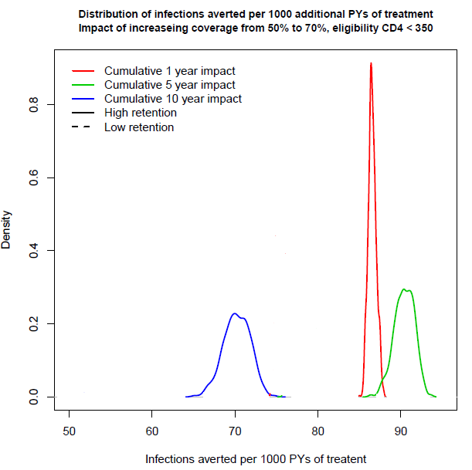
Infections Averted per 1,000 Patient-Years of Treatment
5 years
10 years
1 year
Source: Tim Hallett, Imperial College; The Impact of Treatment on HIV Incidence: Perspective from Epidemiology & Modelling

Slide 12
Current Limitations of PACM Estimates
Input parameter for secondary sexual transmissions that occur from non-acute PLWHA not on treatment requires further validation
Base-case: Rate of 0.070 implies $147 per life-year saved
CI: Rate of 0.560 – 0.930 implies $172 - $110 per life-year saved
Model does not capture dynamic effects of increased treatment coverage reducing community infectiousness
Inclusion would likely improve estimated cost-effectiveness
No quality or disability adjustments currently estimated for life-years saved
Inclusion would worsen estimated cost-effectiveness
Productivity gains from averted mortality and morbidity not currently estimated
Inclusion would improve estimated cost-effectiveness

Slide 13
Preliminary projections: Epidemic Impact and Cost of Accelerated Scale-up
Modeling the Impact and Costs of Treatment

Slide 14
Modeling the Impact and Costs of Treatment in PEPFAR-Supported Programs
Two complementary analytic approaches:
Estimation of health impact and net societal cost of PEPFAR-supported treatment
Estimation of longer-term epidemic impact and costs of accelerated scale-up in light of HPTN 052

Slide 15
Modeled Example: Accelerated Treatment Scale-Up in Kenya
Desire to understand the potential epidemic impact and resource implications of accelerated treatment scale-up, in light of HPTN 052 findings
What might be done in light of global health resource constraints?
Understand the magnitude of economies required to allow accelerated scale-up
Collaboration with John Stover (Futures Institute)
Model based on AIDS Impact Model (AIM)/Spectrum to estimate epidemic impact and cost
Cost parameters derived from CDC’s PEPFAR ART Cost Model
Kenya chosen as an example setting

Slide 16
Modeled Scenario: Rapid expansion of ART to patients already identified as HIV-infected
Priority groups for accelerated access in scenario:
Patients with CD4 <500 cells/µl already on waiting lists for ART or in pre-ART care
Lifelong ART to pregnant and breastfeeding women regardless of CD4 cell count
Patients with active tuberculosis (TB)
Persons known to be in serodiscordant couples regardless of CD4 count

Slide 17
Modeled Scenario: Rapid expansion of ART to patients already identified as HIV-infected
Efficiency gains: Utilizing a public health approach to treatment, it is assumed that costs might be further reduced
Standardized package of care and treatment
Increased task-shifting
Decentralization of care
Streamlined commodity procurement and management
For Kenya example
Treatment cost decline is modeled to decrease from $668 to $491, over 5 years (26.5% decrease compared to current)
Base case: Maintenance of 2011 coverage, no efficiency gains

Slide 18
Base-Case for Kenya Projects 70% Coverage of Those Eligible for Treatment (CD4<350)
Based on PEFPAR 2011 APR data

Slide 19
To Maintain Base Treatment Coverage, Continued Increase in Treatment Required

Slide 20
Treatment Resources Would Need to Increase to Maintain Base Coverage Levels

Slide 21
With Accelerated Scale-Up an Additional 323,000 are Moved to Treatment from Current Clinical Care and PMTCT
Based on population estimates in the following priority populations: patients in care with CD4<500, PMTCT patients, HIV patients with active TB, known PLHA in sero-discordant couples

Slide 22
Accelerated Scale-Up Results in Annual Decline in New HIV Infections
Under the base-case scenario, incident HIV infections remain relatively constant at or above 120,000 new cases per year. With accelerated treatment scale-up, incident HIV infections could be driven down to ~86,500 by 2015.

Slide 23
Per Patient ART Costs ($/patient), under Base Case and Efficiency Assumptions

Slide 24
Under Accelerated Scenario Annual Treatment Costs Reach Steady State Over Time
Millions
Estimated costs to maintain current coverage levels in the Base Case and Accelerated Scale-Up Scenario. Flattened treatment costs in the accelerated scale-up scenario reflect effects of declining HIV incidence and additional implementation efficiency.

Slide 25
Preliminary Findings from Accelerated Treatment Projections for Kenya
Accelerated scale-up could reduce incident infections by 31% over five years
A flattened program results in steady incidence and a growing population of those in need of treatment
With reasonable assumptions for continued efficiency gains, accelerated scale-up possible within constrained budget
In the longer term, accelerated scale-up may be cost-saving
Over five years in the context of the Kenyan epidemic, 93 infections are projected to be averted for every additional 1000 patient-years of treatment provided

Slide 26
Acknowledgments
John Stover – Futures Institute
Nalinee Sangrujee – CDC-Atlanta
Nick Menzies – Harvard, CDC-Atlanta
J. Michel Tcheunche – CDC-Atlanta
Vimalanand Prabhu – CDC-Atlanta
Kipruto Chesang – CDC-Kenya
Lucy Nganga – CDC-Kenya
Andrea Kim – CDC-Kenya
Nancy Knight – CDC-Kenya
Jan Moore – CDC-Atlanta
Laura Broyles – CDC-Atlanta
Center for Global Health
Division of Global HIV/AIDS

